Slide 1
AI Use Case Identifier
IRONHACK · PROJECT 3 · DEMO DAY
Company name and website in. A pre-meeting brief with three grounded AI use cases out.
Fritz Tschoepke · autonomous research agent built on LangGraph
Notes:
0:00–0:15. One sentence only: "I built an agent that prepares an AI consultant for a first meeting with a company it has never spoken to." Terminal is already open in the project folder, venv active, command typed but not sent.

Slide 2
The first meeting is spent guessing
PROBLEM AND USER
SMEs ask "where could AI help us?"
Better be prepared.
THE USER
An AI consultant preparing a first conversation with an SME of 20 to 500 people.
THE PAIN
Either hours of research per prospect, or a pitch that could be for anyone.
WHY IT MATTERS
That meeting decides whether I can convince the client to hire me as a consultant.
Notes:
0:15–0:55. User = the consultant (me). The brief is a thinking aid, not a deliverable for the client. Point: knowing how the company earns money and where its process hurts turns the first call from discovery-from-zero into validating hypotheses.

Slide 3
One trigger, five nodes.
AUTONOMY
python -m app.run --company "Uhlmann Beton" --url "https://uhlmann-beton.de/"
site
search
model
match
report
Homepage, about, careers, job postings
News and register entries via Tavily
Business model, unit economics, process map
Rubric rating, Pinecone retrieval, rerank, three picks
Markdown brief, state.json, process-map image
No node can stop the run. A blocked site or failed call becomes a note, and the note becomes a question for the meeting.
Notes:
0:55–1:30. Read the command out loud, switch to the terminal, press Enter, show the first "[ x.xs] site done" line, then come straight back to the slides. The run finishes in the background while you show the next two slides (these are from the saved Uhlmann Beton run of this morning = your backup if an API fails). Say explicitly: "From here on I don't touch it."

Slide 4
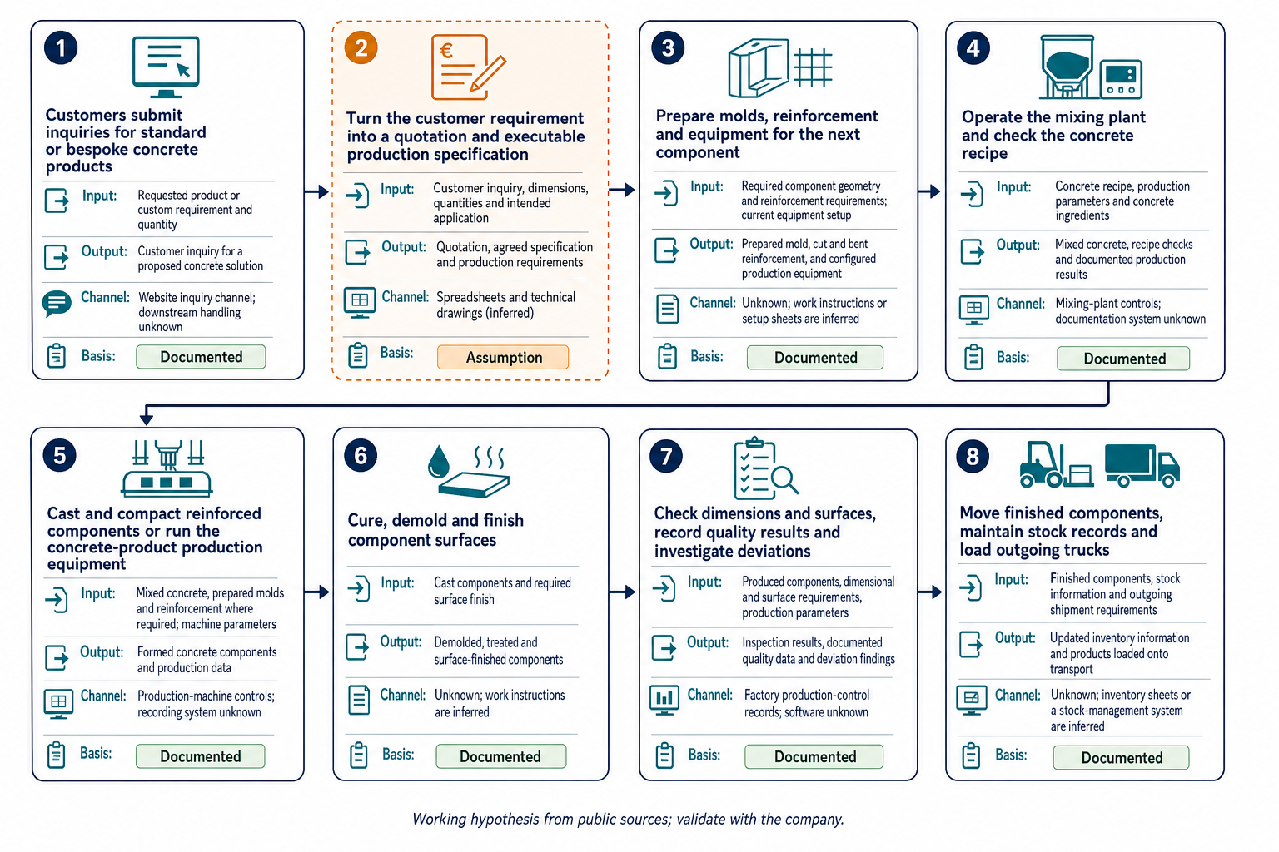
How the company runs, with evidence marked
THE REPORT · PART 1
DOCUMENTED · 7 OF 8 STEPS
Every claim cites a source id. Python swaps the id for its URL.
ASSUMPTION · STEP 2, QUOTATION
No valid source id? Code downgrades the claim, whatever the model said.
Uhlmann Beton, precast-concrete manufacturer in Rudolstadt. Saved run of 13 November.
Notes:
1:30–2:15. Why useful: the consultant sees at a glance what is known and what to verify. The one orange card (quotation and production specification) is not on the website, so it becomes a question for the meeting. Most of the documented steps come from the job postings on the careers page.

Slide 5
Three use cases, plus a more speculative one.
THE REPORT · PART 2
01 · Quick win
02 · Strategic bet
03 · Quick win
Prepare structured inquiry packets for sales
Assist estimators with geometric quantities for bespoke offers
Refresh an internal finished-stock exception report
Lever: lower cost per unit
AI runs it
Lever: more units sold
A person leads, AI assists
Lever: lower cost per unit
AI runs it
OPTION B · AUGMENT, NOT SUBSTITUTE
Today Uhlmann prices the design a customer submits. With AI, engineers could offer several costed, manufacturable alternatives early and discuss the trade-offs with the customer.
Engineer-led alternative design service
Speculative, for the meeting
Notes:
2:15–3:15. Top row: three library-backed cases that support the process as it runs today. Each has: how the work runs with AI, money effect, reference pattern, pilot. Code only lets the model adapt cards it actually retrieved. Bottom band (about 20 seconds): the report also redesigns one process as Option B. Option A copies what people already do; Option B gives people a capability they did not have. Here: engineers get comparable design alternatives for geometry, mold reuse and order grouping, and use them in an options session with the customer. It is marked as speculation, not as a fourth use case. Then switch to VS Code: show the five "done" lines and the report path, open outputs/uhlmann-beton/report.md in preview and scroll once from top to "Questions for the first meeting". Max 45 seconds on screen. If the run failed or is still going: open samples/ankerstein.md, say "this is a saved run for another company", move on.

Slide 6
Why LangGraph and not n8n
STACK RATIONALE
Most of the work is checking what the AI returns. That is easy in code and awkward in drag-and-drop.
EVERY CLAIM IS TRACEABLE
WHAT N8N DOES BETTER
All five steps fill in one shared record. It is saved with every report, so I can see where each statement came from.
Connecting apps like web forms, email and CRM, without code.
THE CODE CHECKS THE AI
A claim without a source becomes an assumption. Use cases must come from the library. If not, the model has to try again.
ONE REPO, ONE COMMAND
Anyone can run it: install, add the API keys, one command. Every change to prompts and rules is tracked in Git.
That is sprint 3. n8n becomes the front door, the graph stays the same.
Notes:
3:15–4:00, about 45 seconds. SAY: "Why LangGraph and not n8n? I could have built it in n8n. But most of the work is checking and reshaping what the model returns, and in n8n that would be code hidden in boxes. In code I get three things. One: every claim is traceable. All five steps fill in the same record, and it is saved next to every report. Two: the code checks the AI. A claim without a source is downgraded to an assumption. The three use cases must come from library cards that were actually retrieved. If not, the model gets one retry. Three: one repo, one command. Anyone can clone it, add the API keys and run it. And every change to a prompt or a rule is in Git. n8n is better at connecting apps: forms, email, CRM. That is exactly sprint three. n8n becomes the front door, LangGraph stays the brain." IF ASKED: - Technical term for point one: shared typed state (a Pydantic RunState, saved as state.json). - Technical term for point two: structured output plus validation in Python. - "Your flow is linear, why a graph?" True today. LangGraph gives me the typed state and per-node progress for free, and a retry loop or a human approval is one extra edge later. - "Is n8n completely out?" No. Its public workflow templates are one source for the use-case library, and it is the trigger in sprint three. - Weak spot to admit: a non-technical client can read an n8n workflow, not my Python. That matters if a client has to maintain it, not for a tool I use myself.

Slide 7
Prove it in the room, then sell it, then open it
GO-TO-MARKET · TWO-WEEK SPRINTS
Sprint 1
Sprint 2
Sprint 3
Thinking aid in real first meetings
Paid entry offer
Web lead magnet
Fixed-price half-day „AI use case workshop“ for manufacturers with a dealer network ( a lot of nice use cases here). 50 personalized previews will be sent to suitable prospects.
A form triggers the graph by webhook and returns a light report for email and phone.
Eight to ten discovery calls prepared with the brief. Log what was right and wrong.
7 of 10 calls confirm or reject a use case · 3 lead to a proposal
2 paid workshops · 10% reply rate
25 requests · 20% reachable by phone
Notes:
4:00–5:00. Order matters: validate accuracy with warm contacts before putting anything public. The buyer is always the SME owner or managing director, never other consultants.

Slide 8

CLOSE
A company name went in. A meeting plan came out.
github.com/Ztirf91/Project3---AI-Use-case-identifier
Recording: [link] · Backup report: samples/ankerstein.md
Notes:
5:00–5:30. Thirty seconds of buffer before the hard stop at 6:00. Limits if asked: public data only, estimates are labelled, the brief is a hypothesis for a conversation.

